Slide 1

VISVESVARAYA TECHNOLOGICAL UNIVERSITY BELAGAVI-590018
DEPARTMENT OF COLLEGIATE AND TECHNICAL EDUCATION
INTERNSHIP PRESENTATION ON
Core Java
PRESENTED BY
BHAGYA RAJU NAIK
4HG21CS403
In partial fulfillment of the department for the award of the bachelor degree in
Computer Science and Engineering
Under the Guidance of
Dr.Raghu M.E
Associate Professor, Dept of CSE
GOVERNMENT ENGINEERING COLLEGE, MOSALEHOSAHALLI
2023-2024

Slide 2



CONTENTS
INTRODUCTION
PROBLEM STATEMENT
OBJECTIVES
ADVANTAGES AND DISADVANTAGES
REQUIREMENT ANALYSIS
METHODOLGY
SNAPSHOT
CONCLUSION
REFERENCES

Slide 3
INTRODUCTION
Core JAVA:
The phrase Core Java defines the basic Java that covers the basic concept of Java programming language. We all are aware that Java is one of the well-known and widely used programming languages, and to begin with it, the beginner has to start the journey with Core Java and then towards the Advance Java. The Java programming language is a general-purpose programming language that is based on the OOPs concept.

Slide 4
INTRODUCTION
IntelliJ IDEA :
IntelliJ IDEA is a widely used integrated development environment (IDE) primarily designed for Java development but also supports other languages. IntelliJ IDEA is used to develop software since it has features including code editing, debugging, testing and project management across various programming languages.

Slide 5
INTRODUCTION
TICTACTOE GAME:
Tic Tac Toe is typically played on a 3x3 grid. So, we need to represent this grid/board in your Java program. A common of characters to represent the board. Each cell of the array can hold one of three values: ’X’, ’O’ represents an empty cell, ’X’ represents a move by player 1, and ’O’ represents a move by player 2. In Tic Tac Toe, players take turns to make their moves. You need to keep track of whose turn it is. A simple way to do this is by using a variable to represent the current player. This variable alternates between ’X’ and ’O’ after each move.

Slide 6
Problem Statement
The problems are solved by forming a possible set of solutions based on the end game condition, or searching for the set of solutions based on the current game condition. The machine cannot learn to play the games by itself. Unlike an evolutionary approach was employed to evolve and to learn for playing Tic-Tac-Toe without the need of a database. Tic-tac-toe is a pencil-and-paper game for two players X and O, The player who succeeds in placing three respective marks in a horizontal, vertical, or diagonal row wins the game.

Slide 7
OBJECTIVES
• Platform independence
• Object-oriented programming
• Memory management
• Security
• Multithreading

Slide 8
ADVANTAGES
java
TICTACTOE
• It is Simple
• Simple rules
• It is an OOP’s Language
• Quick to play
• Multithreading
• Promotes strategic thinking
• Automatic Garbage Collection
• Encourages Problem-Solving Skills

Slide 9
DISADVANTAGES
JAVA
TICTACTOE
• Slow and Poor Performance:
• Limited Complexity:
• No backup facility:
• Potential for Draws:
•Verbose and complex code
• Minimal Skill Development
• Significant memory space required
• Limited Player Interaction:

Slide 10
REQUIREMENT ANALYSIS
SOFTWARE REQUIREMENTS
HARDWARE REQUIREMENTS
Operating System : Windows 10
Processor : i3 or i5 intel core
Language : Core Java
RAM : 4Gb
IDE : IntelliJ IEDA
Hard Disk : 100Gb

Slide 11
METHODOLGY
• Implement the Game Logic: Inside the TicTacToe class, implement the game logic according to the rules.
• Build and Run the Game: After implementing the game logic, build and run the project to play the game.
• Define the Game Board: You’ll need to represent the Tic-Tac-Toe board. Decide on the size of the
board (typically 3x3).Two symbols are there such as X and O.
• Display the Board: Create a method to display the current state of the board to the players.
• Player Input: Implement a way for players to input their moves. This can be done by accepting input for
the row and column they want to place their mark.
• Check for Winning Condition: After each move, check if there is a winner. The game is won when a
player has placed three of their marks in a horizontal, vertical, or diagonal row.

Slide 12
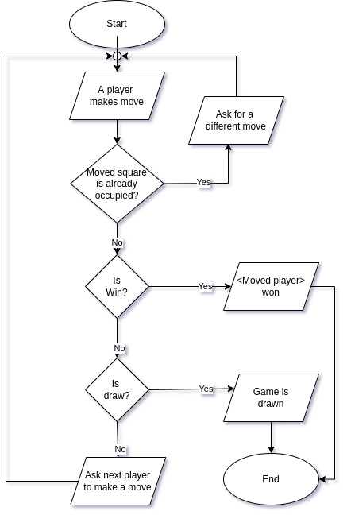
FLOW CHAT

Slide 13
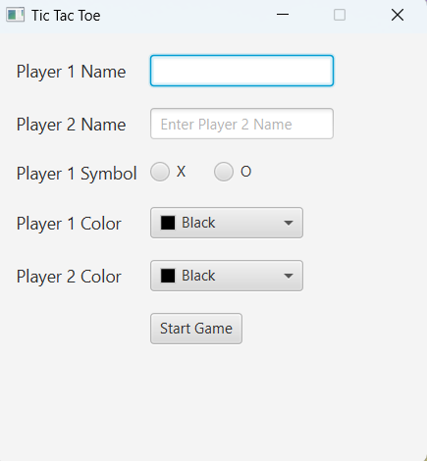
SNAPSHOT

Slide 14
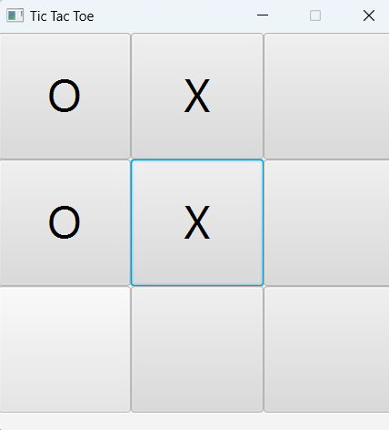

Slide 15
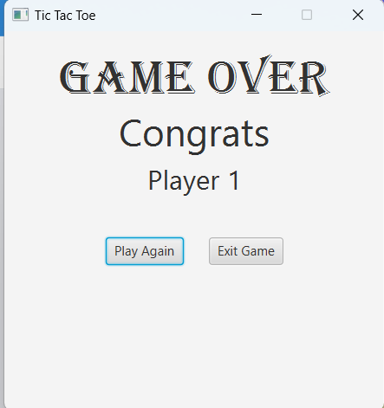

Slide 16
CONCLUSION
The implementation of the Tic-Tac-Toe game in Java using IntelliJ IDEA provides a practical demonstration of software development using a popular integrated development environment (IDE). By leveraging IntelliJ IDEA’s features and tools, developers can ef?ficiently write, debug, and test their code, resulting in a well-structured and functional applications.Tic-Tac-Toeis a classic strategy game that can be enjoyed by people of all ages. The game’s simple rules and objective make it easy to learn, yet difficult to master, providing hours of entertainment and intellectual challenge.

Slide 17
REFERENCES
[1] S. Garg and D. Songara,”The winner decision model of Tic-Tac-Toe” game by using multi-tape turing machine,Sep 2016
[2] Sai Surya Teja Gontumukkala, Yogeshwara Sai Varun Godavarthi, Bhanu Rama Ravi Teja Gonugunta,”Implementation of Tic Tac Toe Game using Multi-Tape Turing Ma?chine”, May 2022.
[3] Dwi H. Widyantoro,Yus G.”Learning to play Tic-tac-toe”,05-07 August 2009.
4] Ghory, Imran,”Reinforcement learning in board games” march -2004.
[5] D.B. Fogel,”Using evolutionary programing to create neural networks that are capable of playing tic-tac-toe”, 28 March 1993 - 01 April 1993.

Slide 18
THANK YOU

